Slide 1
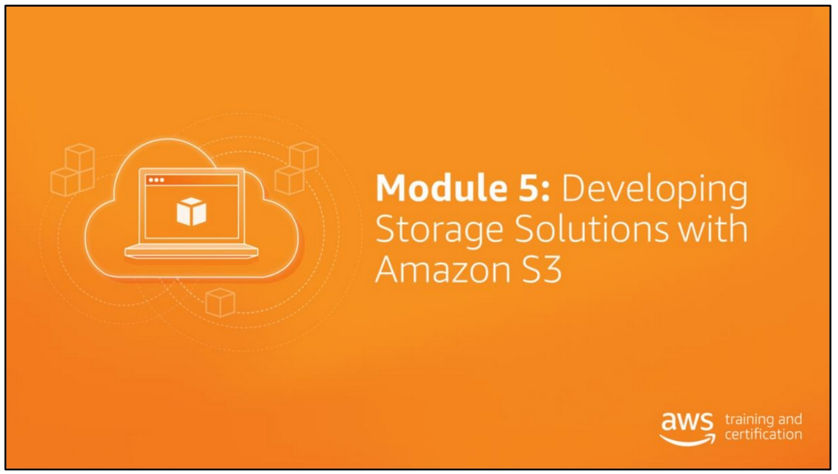

Slide 2
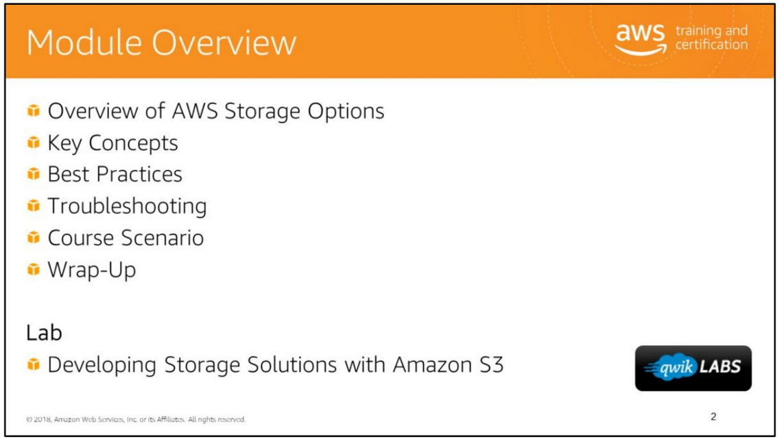

Slide 3
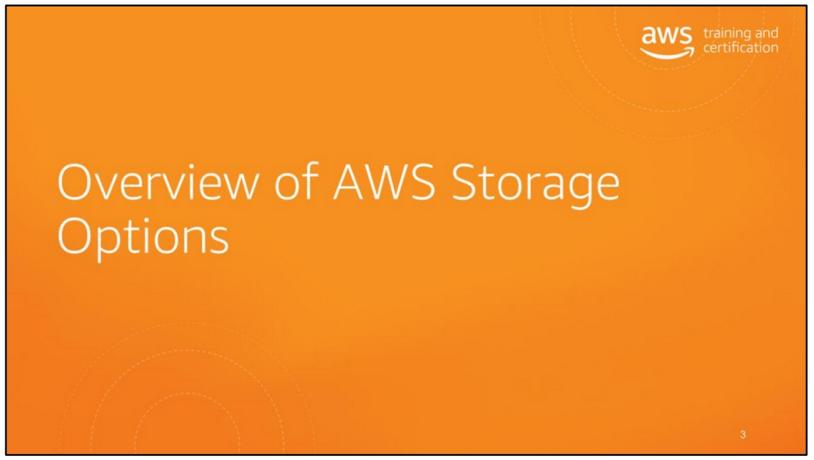

Slide 4
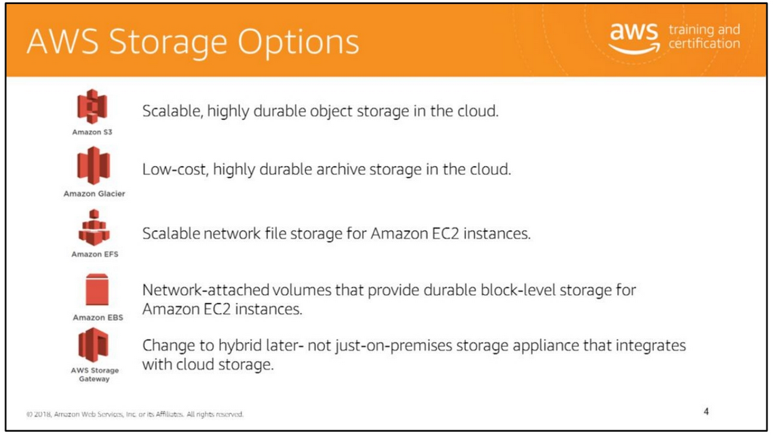
flexible storage for data archiving and online backup. Store your data for as little as $0.004 per gigabyte per month.
You store data in Amazon Glacier as archives. An archive can represent a single file, or you can combine several files to be uploaded as a single archive.
Types of retrieval:
• Expedited retrievals typically return data in 1–5 minutes, and are great for Active Archive use cases.
• Standard retrievals typically complete between 3–5 hours, and work well for less time-sensitive needs like backup data, media editing, or long-term analytics.
• Bulk retrievals are the lowest-cost retrieval option, returning large amounts of data within 5–12 hours.
Use cases include archiving offsite enterprise information, media assets, and research and scientific data, and also performing digital preservation and magnetic tape replacement.

Slide 5
Amazon EFS: Amazon EFS delivers a simple, scalable, elastic, highly available, and highly durable network file system as a service to EC2 instances.
It’s designed to provide a highly scalable network file system that can grow to petabytes, which allows massively parallel access
from EC2 instances to your data within a region.
It is also highly available and highly durable because it stores data and metadata across multiple Availability Zones in a region.
Amazon EFS supports highly parallelized workloads and is designed to meet the performance needs of big data and analytics, media processing,
content management, web serving, and home directories.
Amazon EBS: Amazon EBS volumes provide durable block-level storage for use with EC2 instances.
Amazon EBS volumes are network-attached storage that persists independently from the running life of a single EC2 instance.
Amazon EBS is designed for application workloads that benefit from fine-tuning for performance, cost, and capacity.
Amazon EBS also provides the ability to create point-in-time snapshots of volumes, which are stored in Amazon S3.
EBS typical use cases include big data analytics engines (like the Hadoop/HDFS ecosystem and Amazon EMR clusters), relational
and NoSQL databases (like Microsoft SQL Server and MySQL or Cassandra and MongoDB), stream and log processing applications
(like Kafka and Splunk), and data warehousing applications (like Vertica and Teradata).
AWS Storage Gateway: AWS Storage Gateway connects an on-premises software appliance with cloud-based storage to provide seamless
and secure storage integration between an organization’s on-premises IT environment and the AWS storage infrastructure like Amazon S3,
Amazon Glacier and EBS.
AWS Storage Gateway use cases include corporate file sharing, enabling existing on-premises backup applications to store primary backups
on Amazon S3, disaster recovery, and mirroring data to cloud-based compute resources and then later archiving it to Amazon Glacier.
Use cases include archiving offsite enterprise information, media assets, and research and scientific data, and also performing digital preservation and magnetic tape replacement.

Slide 6
Glacier is flexible storage for data archiving and online backup. Store your data for as little as $0.004 per gigabyte per month.
You store data in Amazon Glacier as archives. An archive can represent a single file, or you can combine several files to be uploaded as a single archive.
Types of retrieval:
• Expedited retrievals typically return data in 1–5 minutes, and are great for Active Archive use cases.
• Standard retrievals typically complete between 3–5 hours, and work well for less time-sensitive needs like backup data, media editing, or long-term analytics.
• Bulk retrievals are the lowest-cost retrieval option, returning large amounts of data within 5–12 hours.
Use cases include archiving offsite enterprise information, media assets, and research and scientific data, and also performing digital preservation and magnetic tape replacement.

Slide 7
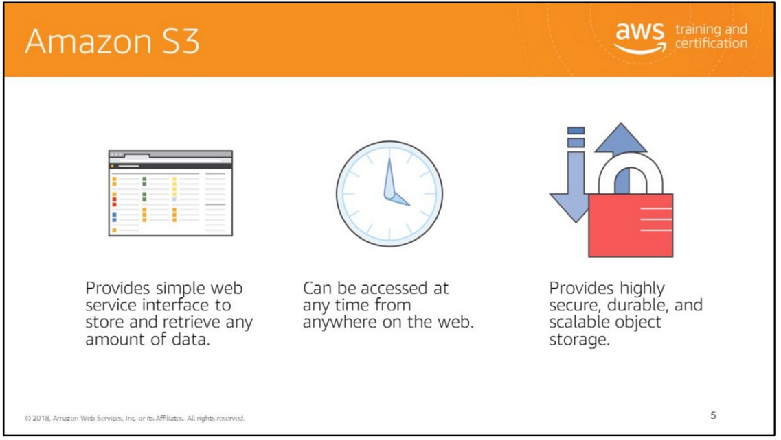
Amazon Simple Storage Service or Amazon S3 provides developers and IT teams with highly secure, durable, and scalable object storage. Amazon S3 is easy to use, with a simple web service interface to store and retrieve any amount of data from anywhere on the web.
You can use the Amazon S3 service by itself or integrate it with other AWS services to build sophisticated solutions.
For more information, see https://aws.amazon.com/s3/.

Slide 8
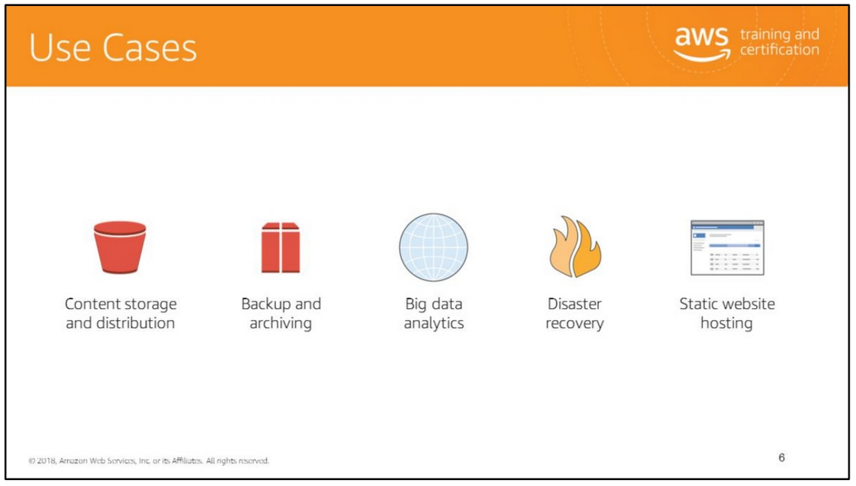
Amazon S3 can be used as a storage solution for use cases such as content storage and distribution, backup and archiving, big data analytics, static web site hosting, and disaster recovery.
Consider a media company that needs to store and distribute media files. The company can use Amazon S3 as a store for all media content and then distribute the content directly from Amazon S3 or distribute it through Amazon CloudFront edge locations.
Amazon S3 provides a secure and scalable solution for backup and archiving. You can backup your data and use storage lifecycle policies to archive rarely accessed data to Amazon Glacier.
Whether you’re storing pharmaceutical or financial data, or multimedia files such as photos and videos, Amazon S3 can be used as your big data object store.
You can host your entire static website on Amazon S3 for a low-cost, highly available hosting solution that can scale automatically to meet traffic demands. On a static website, individual web pages include static content. They may also contain client-side scripts.

Slide 9
Amazon S3’s highly durable, secure, global infrastructure offers a robust disaster recovery solution. Cross-Region Replication (CRR) automatically replicates every S3 object to a destination bucket located in a different AWS region.
6 Waves Limited is a leading publisher and developer of gaming applications on the Facebook platform. 6 Waves uses Amazon S3 and Amazon Elastic Compute Cloud (EC2) services to host over 50 million players monthly on their online games. The decoupling of storage from server instances largely simplifies disaster recovery and sizing. For more information, see https://aws.amazon.com/solutions/case-studies/6waves/ .
Classle is a cloud-based social learning platform that allows students to connect with other students and professionals from various areas. Amazon S3, with the Reduced Redundancy Storage (RRS) feature, serves the dual function of providing Classle’s content downloads and acting as an origin server for Amazon CloudFront. For more information, see https://aws.amazon.com/solutions/case-studies/classle/ .

Slide 10
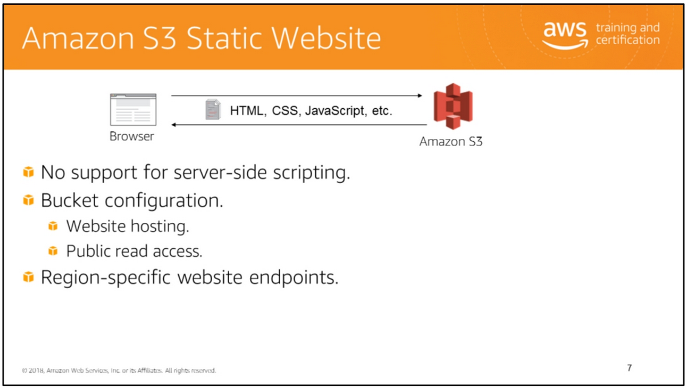

Slide 11


Slide 12
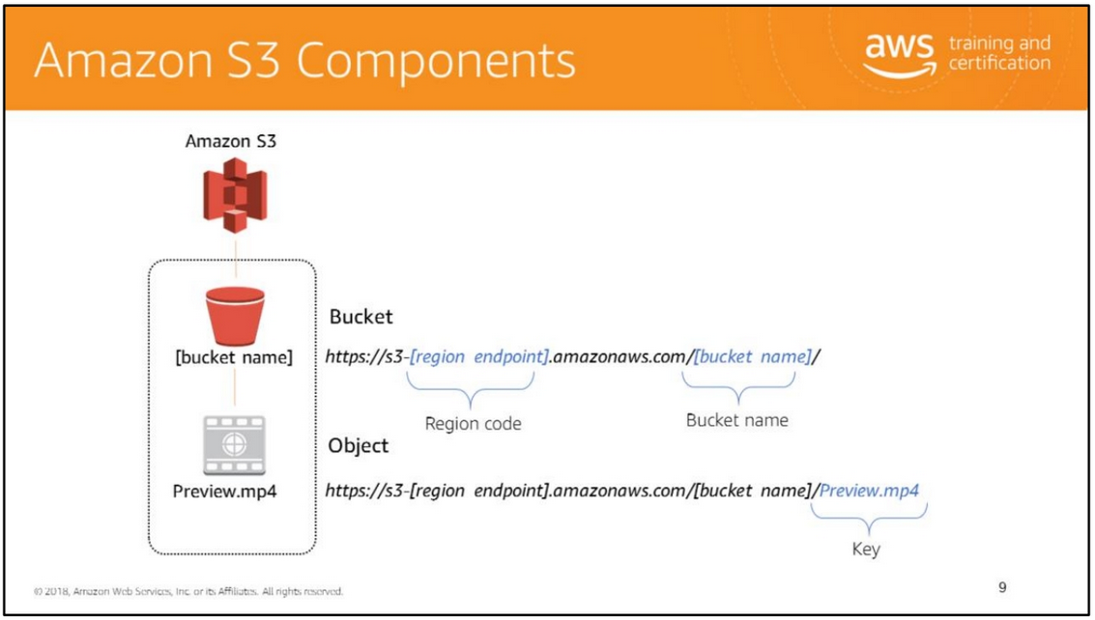
The basic components of Amazon S3 are the bucket itself, objects, keys, and the unique object url.
In the example here, we can use Amazon S3 to create a bucket in the US Oregon region, which is identified within AWS formally by its region code, as “us-west-2".
The URL for a bucket is structured as displayed here, with the region code first, followed by amazonaws.com, followed by the bucket name.
Amazon S3 refers to files as "objects. “ After you have created a bucket, you can store any number of objects inside it. An object is composed of data, and any metadata that describes that file. To store an object in Amazon S3, you upload the file you want to store into a bucket. When you upload a file, you can set permissions on the data and any metadata. A key is a unique identifier for each object in an S3 bucket.
In this example, we're storing the object "Preview.mp4" inside our bucket. The URL for the file includes the object name at the end.

Slide 13
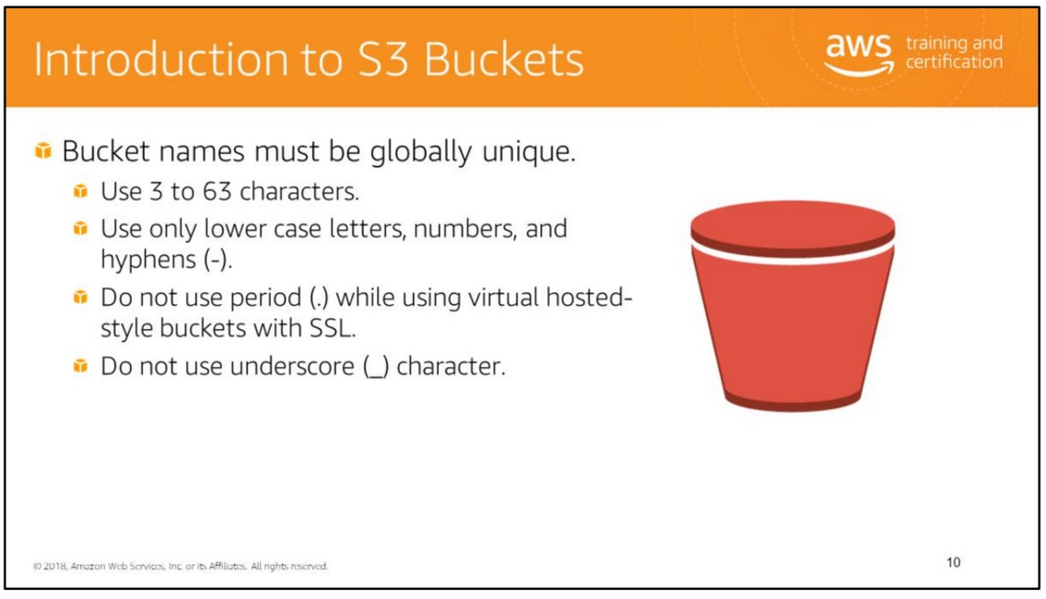
Data is stored in S3 buckets as objects. An object can be any kind of file such as text, video, photo, or another binary format.
The bucket name must be unique across Amazon S3. To ensure uniqueness, you might prefix the bucket name with the name of your organization.
Buckets that have a period in the bucket name can cause certificate exceptions when accessed with HTTPS-based URLs. To support HTTPS access to your bucket, avoid using a period in the bucket name.
For information about S3 bucket restrictions and naming best practices, see https://docs.aws.amazon.com/AmazonS3/latest/dev/BucketRestrictions.html .

Slide 14
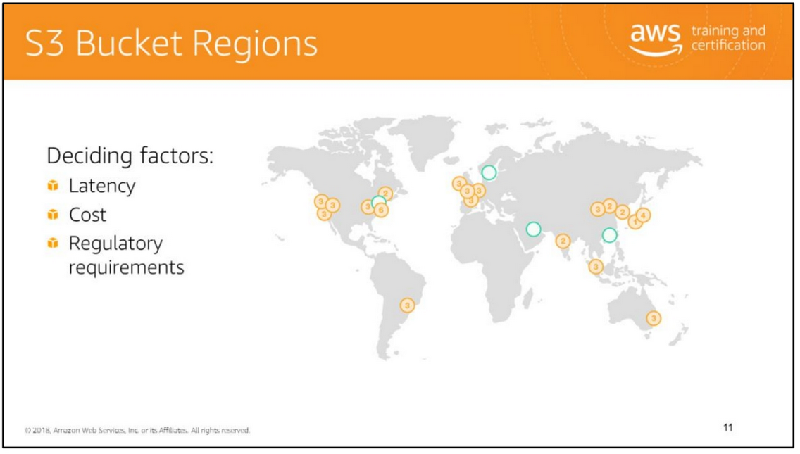
A bucket is associated with a region. Consider factors such as latency, cost, and regulatory requirements before choosing the region in which your S3 bucket will be located. Consider choosing a region close to you to reduce network latency. Check storage costs for each region. Consider regulatory requirements that specify where your data must be stored.
Each region has a more generic region name. For example, the us-east-1 region is also referred to as the US Standard region.
For information about Amazon S3 regions, see http://docs.aws.amazon.com/general/latest/gr/rande.html#s3_region.

Slide 15
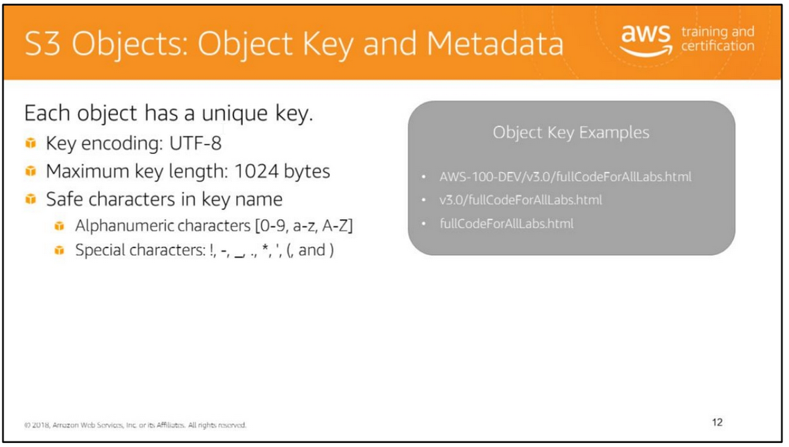
Each file stored in an S3 bucket is considered an object. An object is identified by a unique key. You must specify an object key to upload and retrieve an object. An object key is encoded using UTF-8 encoding. The key has a maximum length of 1024 bytes. Alphanumeric characters and some special characters such as an exclamation mark, hyphen, underscore, period, asterisk, single quote, and forward slash are allowed in a key name.
Key names can also include path prefixes and delimiters to logically group your objects. For example, prog/java/collections.htm. There is no hierarchy of objects or a notion of nested buckets in Amazon S3. So you can specify path prefixes and delimiters in key names to organize similar objects.
Object Metadata An object is associated with system-defined metadata and user-defined metadata.
• System-defined metadata includes information such as object creation date, size, and MD5 digest. You can also associate your own metadata with an object.
• User-defined metadata must be assigned as name-value pairs when you upload an object. When you use the SDK to add metadata, the prefix “x-amz-meta-” is automatically added to the metadata name.
For more information about object keys and metadata, see http://docs.aws.amazon.com/AmazonS3/latest/dev/UsingMetadata.html

Slide 16
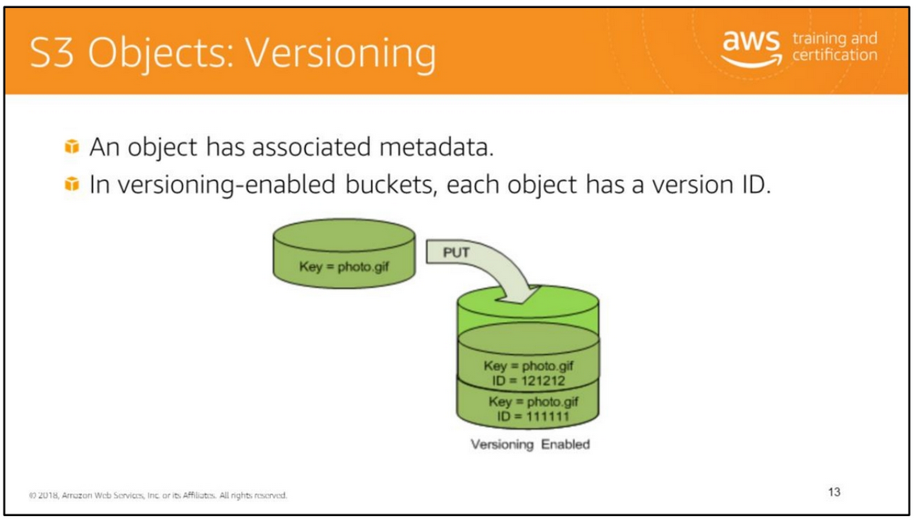
Versioning
An object’s version ID is part of the system-defined metadata. By default, versioning is disabled in S3 buckets.
• In versioning-disabled buckets, an object has a version ID of null.
• In versioning-enabled buckets, each version of an object has a unique version ID.
An example of a version ID is 3/L4kqtJlcpXroDTDmJ+rmSpXd3dIbrHY+MTRCxf3vjVBH40Nr8X8gdRQBpUMLUo

Slide 17
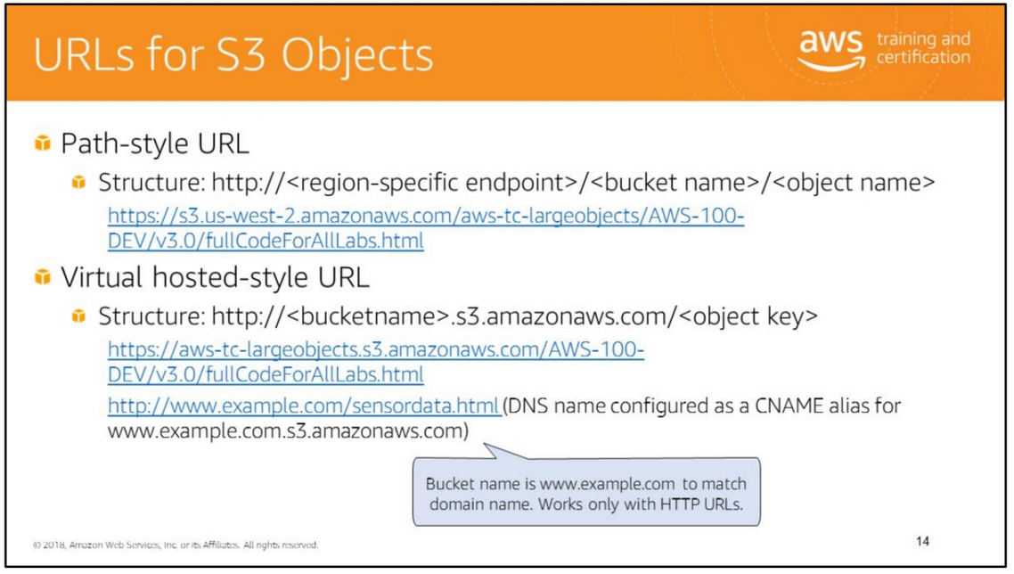
Amazon S3 supports two types of URLs to access objects as described next.
• Path-style URLs require you to specify a region-specific endpoint.
• Virtual hosted-style URLs are more user-friendly because the URLs begin with your custom bucket name. This URL style is useful if you are using your Amazon S3 bucket to host a static website. You can also publish to the "root directory" of your bucket's virtual server. This ability can be important because many existing applications search for files in this standard location. For example, favicon.ico, robots.txt, and crossdomain.xml are all expected to be found at the root.
• Accessing website with HTTP-based URLs: If you name your bucket to match your registered domain name (such as www.example.com) and set that name as a DNS alias for Amazon S3, you can access objects with a customized URL such as http://www.example.com/sensordata.html.
• Accessing website with HTTPS-based URLs: Buckets that have a period in the bucket name can cause certificate exceptions when accessed with HTTPS-based URLs. To support HTTPS access to your bucket, avoid using a period in the bucket name.
For more information about virtual hosting of buckets, see http://docs.aws.amazon.com/AmazonS3/latest/dev/VirtualHosting.html.

Slide 18
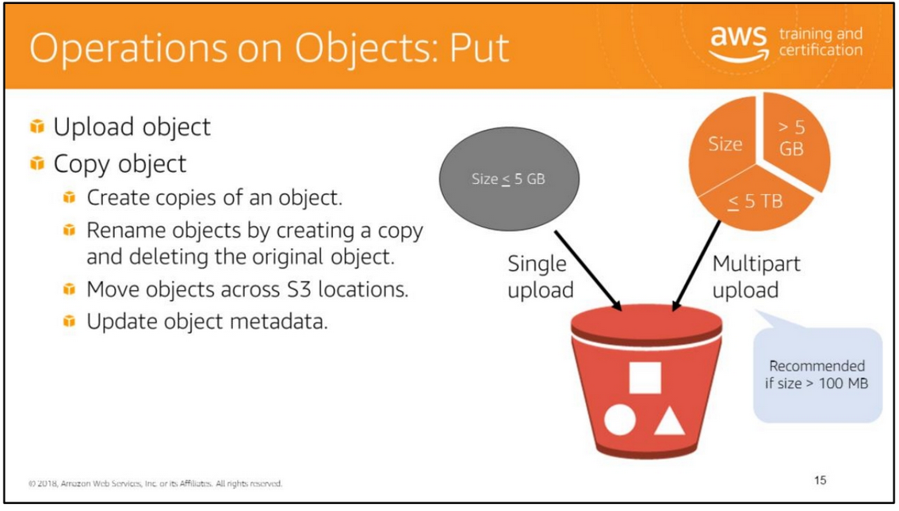
You can upload or copy objects of up to 5 GB in a single PUT operation. For larger objects up to 5 TB, you must use the multi-part upload API.
Multipart upload allows you to upload a single object as a set of parts. You can upload each part separately. If one of the parts fails to upload, you can retransmit that particular part without retransmitting the remaining parts. After all the parts of your object are uploaded to the server, you must send a complete multipart upload request that indicates that multipart upload has been completed. Amazon S3 then assembles these parts and creates the complete object.
You can also abort a multipart upload. When you abort an upload, Amazon S3 deletes all the parts that were already uploaded and frees up storage.
Amazon S3 retains all parts on the server until you complete or abort the upload. Make sure to complete or abort an upload to avoid unnecessary storage costs related to incomplete uploads.
Consider using multipart upload for objects bigger than 100 MB. With multipart uploads you can upload parts in parallel to improve throughput, recover quickly from network issues, pause and resume object uploads, and begin an upload before you know the final size of an object.
Use the copy operation to create copies of an object, rename an object, move it to a different S3 location, or to update its metadata. You can also use the copy operation to change the storage class of an object from standard to reduced redundancy or vice versa. For information about storage class, see http://docs.aws.amazon.com/AmazonS3/latest/dev/ChgStoClsOfObj.html.

Slide 19
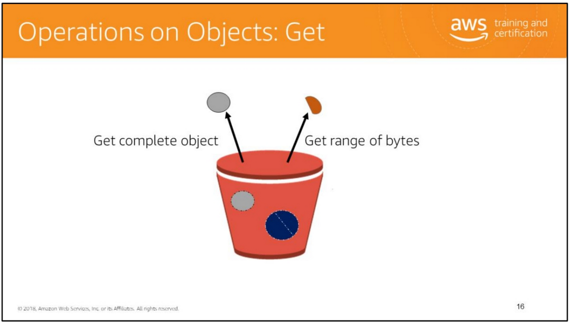
You can retrieve a complete object in a single GET request.
You can also retrieve an object in parts by specifying the range of bytes needed. This is useful in scenarios where network connectivity is poor or your application can or must process only subsets of object data.

Slide 20
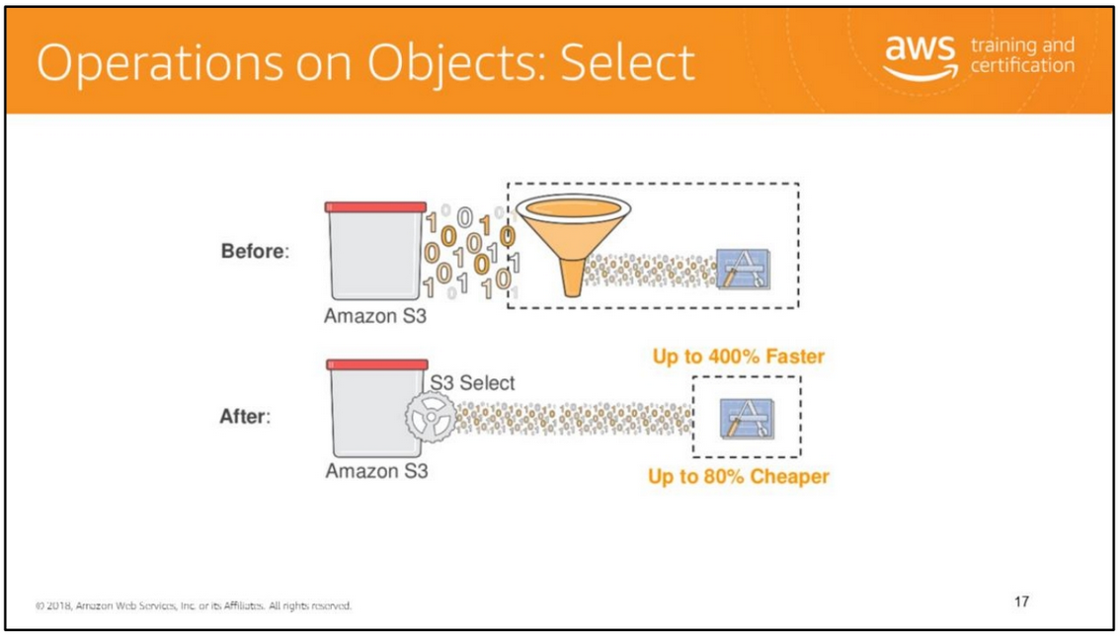
Select content from Object instead of retrieving Object. Filtering of content handled at S3 service level.
Amazon S3 Select analyzes and processes data within an object in Amazon S3 buckets, faster and cheaper. It works by providing the ability to retrieve a subset of data from an object in Amazon S3 using simple SQL expressions.
Your applications no longer have to use compute resources to scan and filter the data from an object, potentially increasing query performance by up to 400%, and reducing query costs as much as 80%.
You simply change your application to use SELECT instead of GET to take advantage of S3 Select.

Slide 21
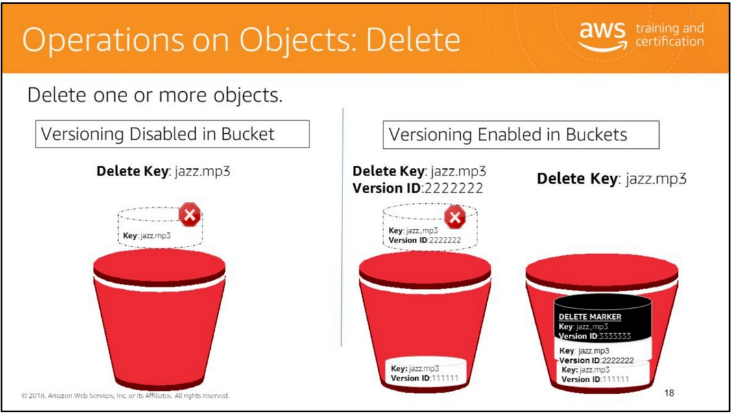
You can delete a single object or delete multiple objects in a single delete request.
Versioning disabled In a bucket that is not versioning-enabled, you can permanently delete an object by specifying the key that you want to delete.
Versioning enabled In a bucket that is versioning-enabled, you can permanently delete an object by invoking a delete request with a key and version ID. You must delete each individual version to completely remove an object.
If you specify a key only, Amazon S3 adds a delete marker which becomes the current version of the object. If you try to retrieve an object that has a delete marker, Amazon S3 returns a 404 Not Found error.

Slide 22
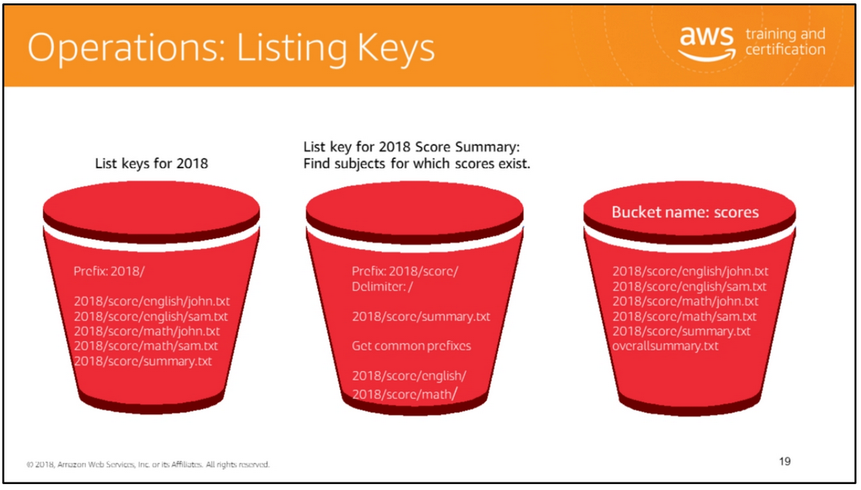
There is no hierarchy of objects in S3 buckets. You can use prefixes (such as 2018) in key names to group similar items.
You can use delimiters (any string such as / or _) in key names to organize your keys and create a logical hierarchy.
If you use prefixes and delimiters to organize keys in a bucket, you can retrieve subsets of keys that match certain criteria. You can list keys by prefix. You can also retrieve a set of common key prefixes by specifying a delimiter.
In the example, the bucket named scores contains objects with English and Math scores of students for the year 2018.
• To list keys related to the year 2018, specify a prefix of 2018/.
• To retrieve the key for the 2018 score summary, specify a prefix of 2018/score/ and delimiter of /. The key 2018/score/summary.txt is returned because it contains the prefix 2018/score/ and does not contain the delimiter / after the prefix.
• To find subjects for which scores are available, list the keys by specifying a prefix of 2018/score/ and delimiter of / and then get common prefixes.
For more information about prefixes and delimiters, see http://docs.aws.amazon.com/AmazonS3/latest/dev/ListingKeysHierarchy.html.

Slide 23
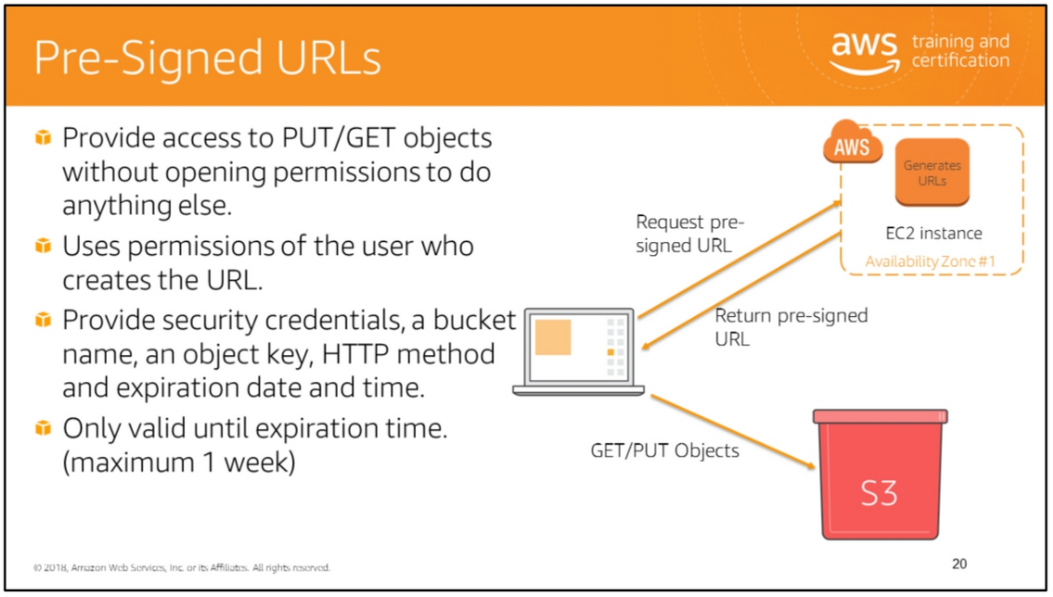
All objects and buckets are private by default. Pre-signed URLs are useful if you want your user to be able upload a specific object to your bucket without being required to have AWS security credentials or permissions. When you create a pre-signed URL, you must provide your security credentials, bucket name, an object key, an HTTP method (PUT for uploading objects, GET for retrieving objects), and an expiration date and time. The pre-signed URLs are valid only for the specified duration.
Share the pre-signed URL with users who need to access your S3 bucket to put or retrieve objects.
Note: Do not share your AWS security credentials (secret access key id) with others.

Slide 24
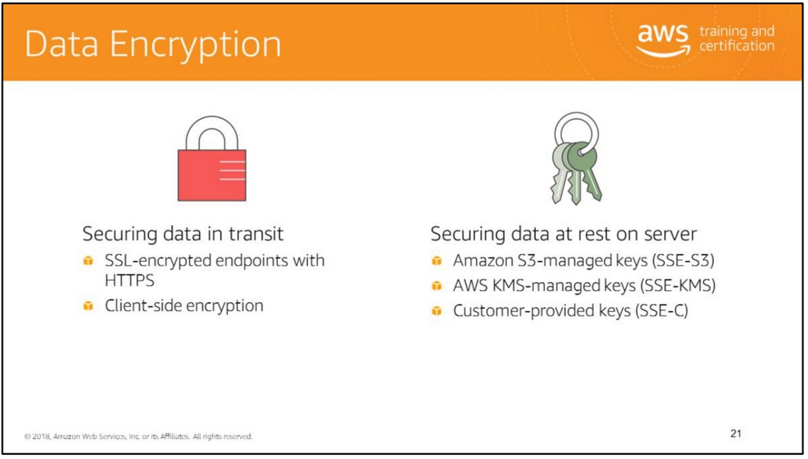
Secure your data in transit and at rest on the server by using the following techniques:
• SSL-encrypted endpoints: You can upload or download your data to Amazon S3 through SSL-encrypted endpoints by using HTTPS.
• Client-side encryption: You can encrypt the data on the client before uploading to the server. For information about which SDKs support client-side encryption, see http://docs.aws.amazon.com/AmazonS3/latest/dev/UsingClientSideEncryption.html .
• Server-side encryption: Amazon S3 encrypts your data at the object level as it writes it to disks in its data centers and decrypts it for you when you access it. For more information, see http://docs.aws.amazon.com/AmazonS3/latest/dev/serv-side-encryption.html .
Server-Side Encryption with Amazon S3-Managed Keys (SSE-S3) Each object is encrypted with a unique key employing strong multi-factor encryption. It also encrypts the key itself with a master key that it regularly rotates. Amazon S3 server-side encryption uses one of the strongest block ciphers available, 256-bit Advanced Encryption Standard (AES-256), to encrypt your data.
Server-Side Encryption with AWS KMS-Managed Keys (SSE-KMS) Similar to SSE-S3, but with some additional benefits along with some additional charges for using this service. There are separate permissions for the use of an envelope key (that is, a key that protects your data's encryption key) that provides added protection against unauthorized access of your objects in S3. SSE-KMS also provides you with an audit trail of when your key was used and by whom. Additionally, you have the option to create and manage encryption keys yourself, or use a default key that is unique to you, the service you're using, and the region you're working in.
Server-Side Encryption with Customer-Provided Keys (SSE-C) You manage the encryption keys and Amazon S3 manages the encryption, as it writes to disks, and decryption, when you access your objects.

Slide 25
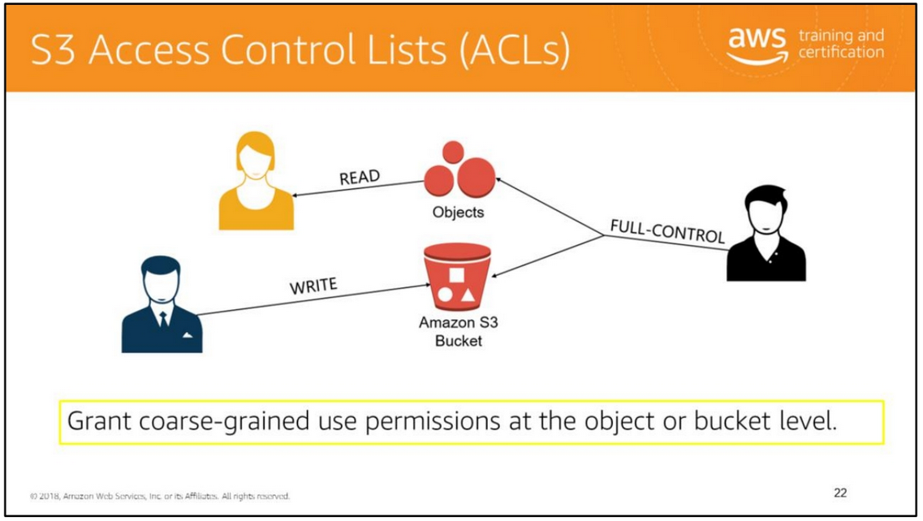
The Amazon S3 access control list allows you to grant least privilege permissions to users to READ, WRITE, or have FULL-CONTROL at the object or bucket level and was created before IAM existed.
ACLs are best used for enabling bucket logging or restricting access to a bucket that will act as a static website that will be world-readable.

Slide 26
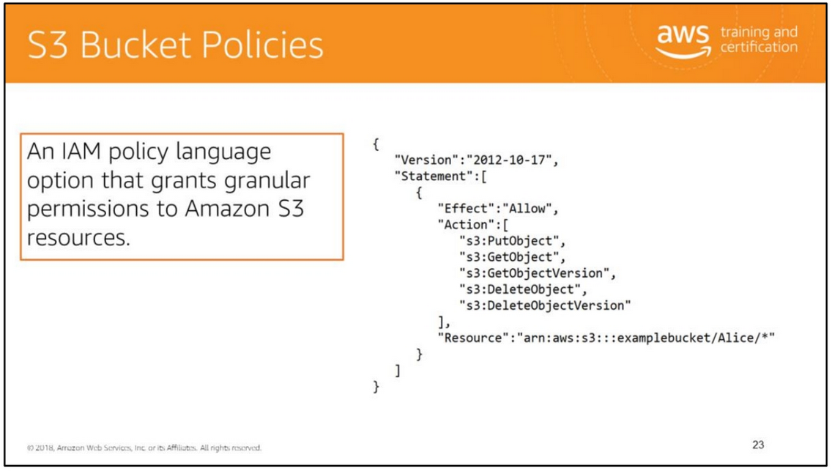
A bucket policy is a resource-based AWS Identity and Access Management (IAM) policy.
You add a bucket policy to a bucket to grant other AWS accounts or IAM users access permissions for the bucket and the objects in it.
Object permissions apply only to the objects that the bucket owner creates.

Slide 27
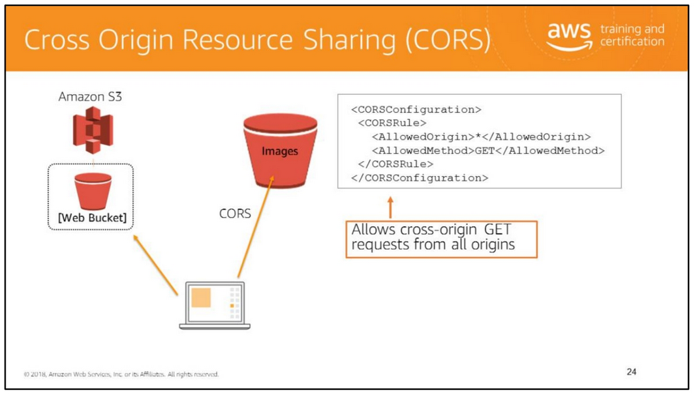
Cross-origin resource sharing (CORS) defines a way for client web applications that are loaded in one domain to interact with resources in a different domain. Consider the following examples:
• You want to host a web font in your S3 bucket. A web page in a different domain may try to use this web font. Before the browser loads this web page, it will perform a CORS check to make sure that the domain from which the page is being loaded is allowed to access resources from your S3 bucket.
• JavaScript in one domain’s web pages (http://www.example.com) wants to use resources from your S3 bucket by using the endpoint website.s3.amazonaws.com. The browser will allow such cross-domain access only if CORS is enabled on your bucket.
With CORS support in Amazon S3, you can build web applications with Amazon S3 and selectively allow cross-origin access to your S3 resources.
To enable CORS, create a CORS configuration XML file with rules that identify the origins that you will allow to access your bucket, the operations (HTTP methods) that you will support for each origin, and other operation-specific information. You can add up to 100 rules to the configuration. You can apply the CORS configuration to the S3 bucket by using the AWS SDK.
For more information, see: • http://docs.aws.amazon.com/AmazonS3/latest/dev/cors.html
• http://docs.aws.amazon.com/AmazonS3/latest/dev/ManageCorsUsing.html

Slide 28


Slide 29
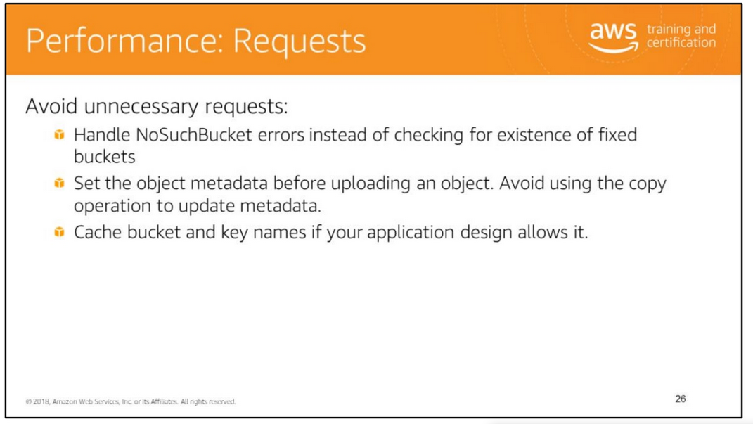

Slide 30
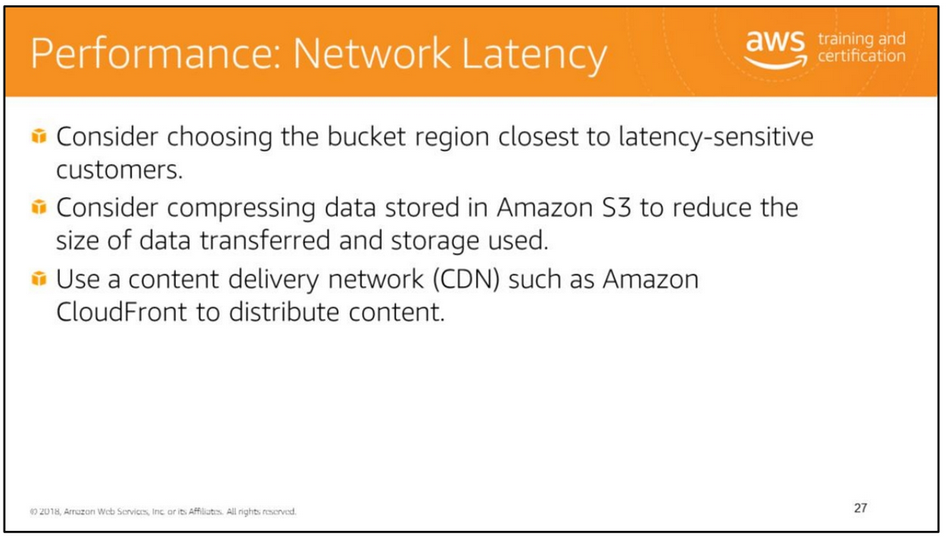
Reduce network latency by selecting a bucket region close to your users, if possible. You will also need to consider other factors such as legal restrictions and cost. Consider compressing data to reduce the size of data transferred. Use a CDN such as Amazon CloudFront to distribute content with low latency and high data transfer speeds.

Slide 31
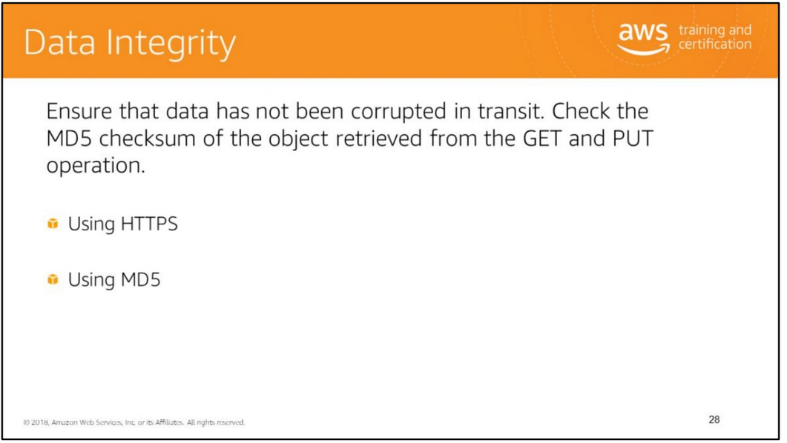
You can check MD5 checksum to ensure that your data was not corrupted in transit.
AWS SDK automatically specifies MD5 checksum in a PUT operation. Amazon S3 recalculates MD5 checksum and compares it with the specified value.

Slide 32


Slide 33
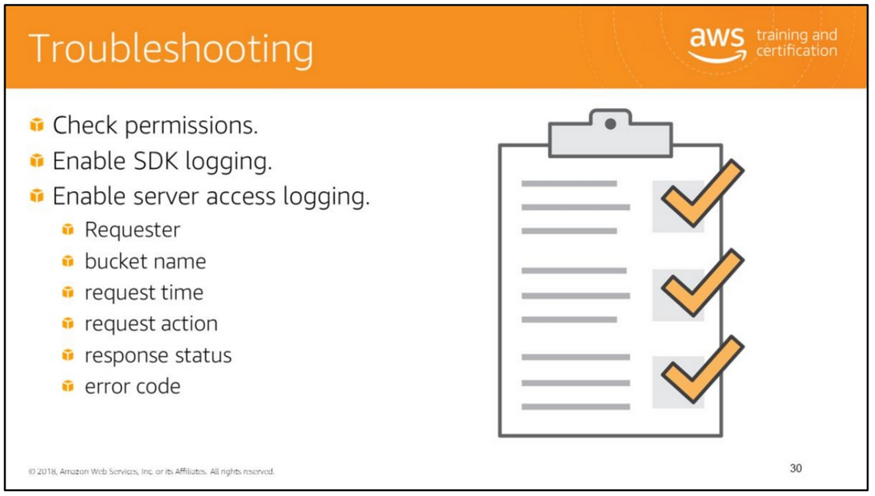
For information about troubleshooting, see:
• Troubleshooting Amazon S3: http://docs.aws.amazon.com/AmazonS3/latest/dev/troubleshooting.html
• How Amazon S3 Authorizes a Request: http://docs.aws.amazon.com/AmazonS3/latest/dev/how-s3-evaluates-access-control.html
• Logging AWS SDK for Java Calls: http://docs.aws.amazon.com/AWSSdkDocsJava/latest/DeveloperGuide/java-dg-logging.html
• Server Access Logging: http://docs.aws.amazon.com/AmazonS3/latest/dev/ServerLogs.html

Slide 34
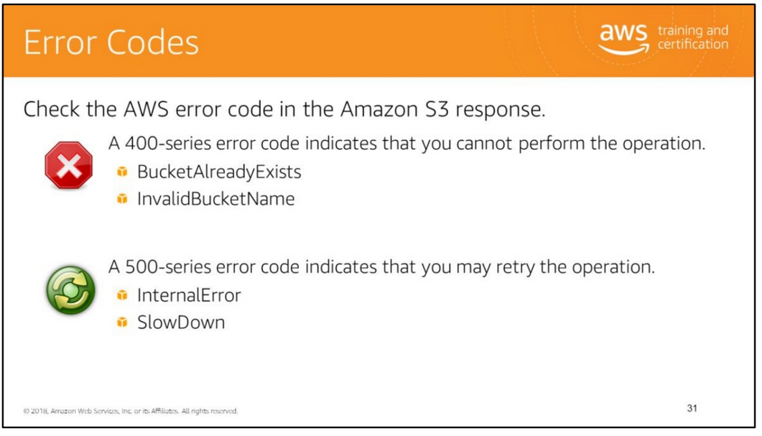
Handle error codes in exceptions gracefully to ensure a smooth customer experience. Use an exponential backoff algorithm to retry after failed connection attempts. With an exponential backoff algorithm, you specify progressively longer waits after each failed attempt before retrying your request.
For more information, see:
• Amazon S3 Error Responses: http://docs.aws.amazon.com/AmazonS3/latest/API/ErrorResponses.html
• Error Retries and Exponential Backoff in AWS: http://docs.aws.amazon.com/general/latest/gr/api-retries.html

Slide 35


Slide 36
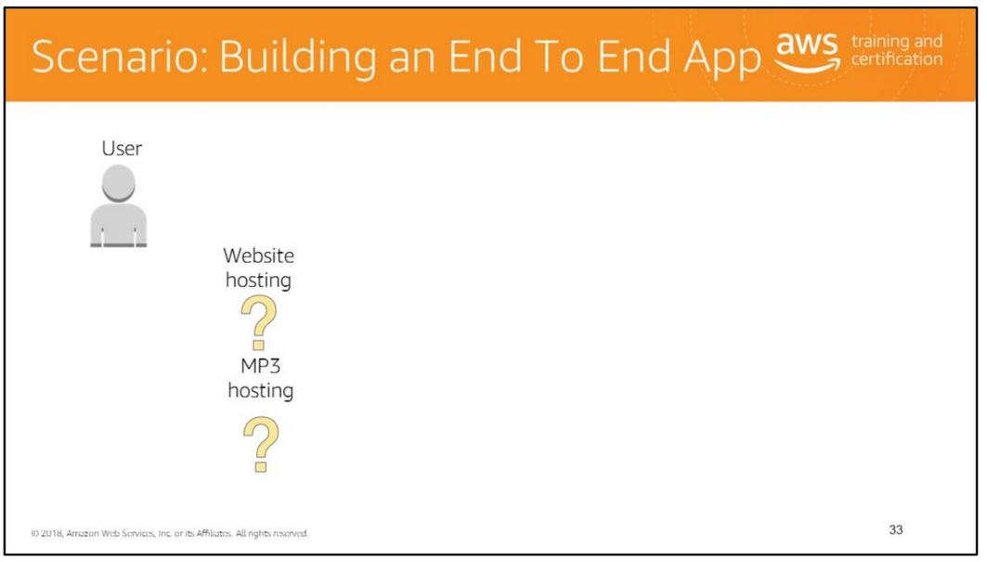

Slide 37
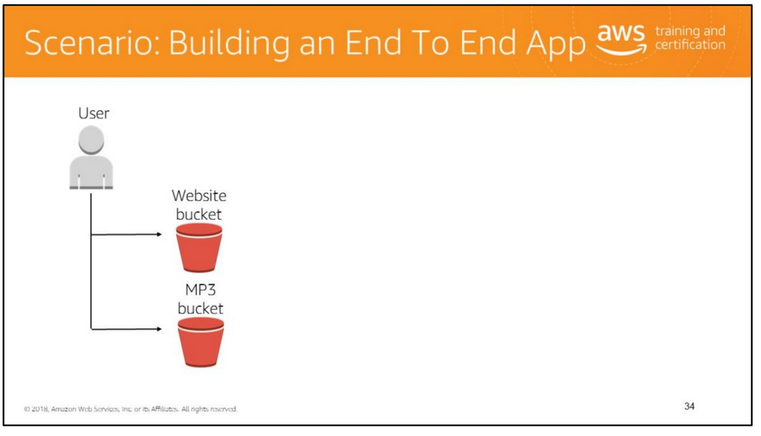

Slide 38


Slide 39
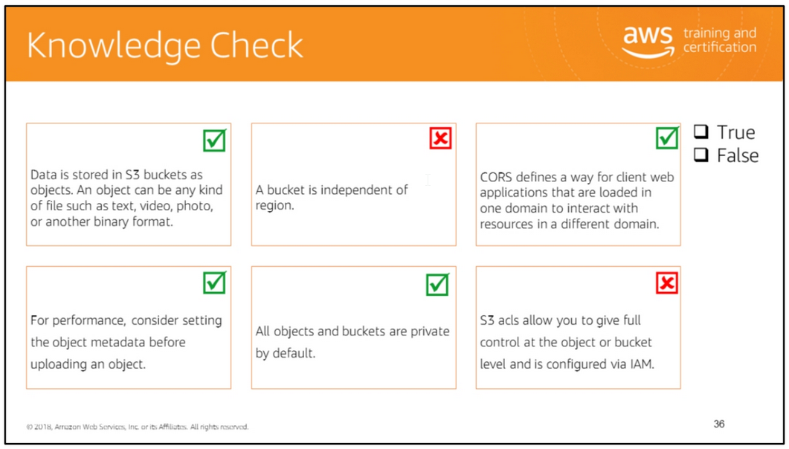
Read left to right:
(True)
(False) It’s not reserved instances, but spot instances are unused EC2 capacity; the price you pay is determined by the supply and demand for the instances.
(True)
(True)
(True)
(False) Sticky sessions can limit your application’s scalability because the load balancer is unable to truly balance the load each time it receives request from a client. With sticky sessions, the load balancer is forced to send all the requests to their original server where the session state was created even though that server might be heavily loaded and there might be another less-loaded server available to take on this request.

Slide 40
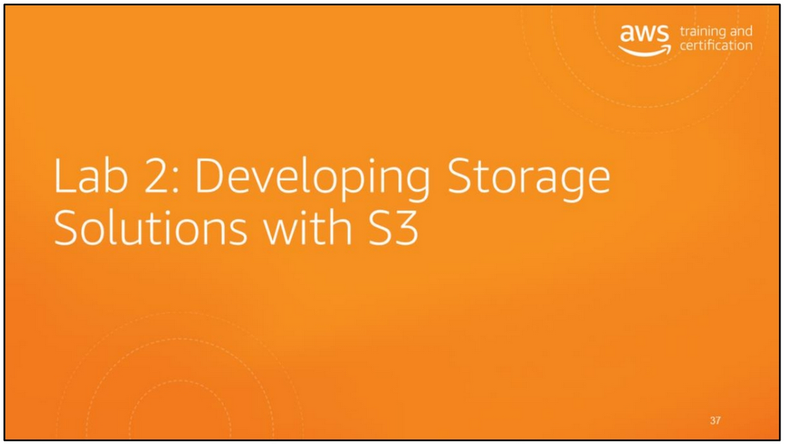

Slide 41
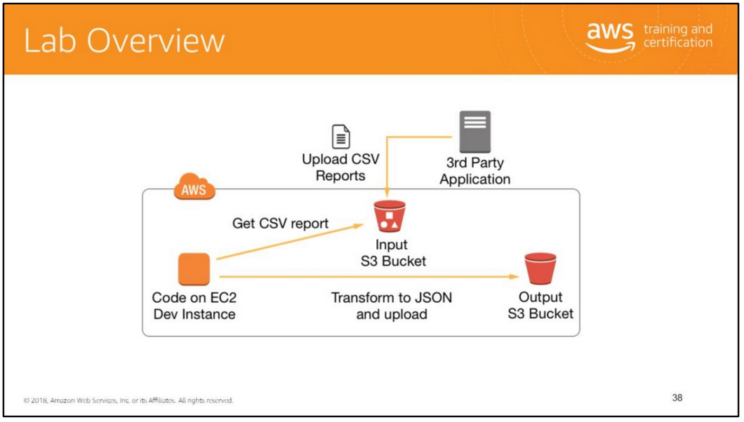
A third-party application drops CSV-formatted reports into an S3 bucket. Another internal application needs to process this data but can only process JSON-formatted content.
You will develop an application that converts every file in the input bucket from CSV to JSON format and uploads the content into an output bucket. You will restrict access to converted files by using pre-signed URLs, encrypt the files, and add a contact person in the user-defined metadata.
You will AWS SDK to:
• Retrieve objects from an S3 bucket.
• Upload objects to an S3 bucket.
• Generate pre-signed URLs for objects.
• Request server-side encryption for objects.
• Add user-defined metadata to objects.

Slide 42
